Slide 1
HR ANALYSIS DASHBOARD by Shubh Jalui
Source: Kaggle

Slide 2
CONTENTS
01
02
03
04
05
Data Collection & Understanding
https://www.kaggle.com/datasets/rhuebner/human-resources-data-set/data Using this as the source from Kaggle.
Data Preprocessing
Loading the dataset into Power BI, understanding and Handling the data
Data Transformation
Cleaning and transforming the data as well as creating new columns for calculated values.
Data Visualization
Creating the visualizations after the transformation to try and interpret the data.
Data Interpretation
Creating meaningful insights from the data from looking at the visualizations.

Slide 3
Data Collection & Understanding
Location: USA
The dataset sourced from Kaggle is a HR Dataset of a company based in 28 out of the 50 States in the USA. It contains total of 36 column, 13 columns in String format, 10 as an ID or key column, 7 in Integer format and other 6 columns in date and decimal format. It has details about Employees and their manager including ex-employees. It has details such as their Salary, Age, Marriage, Position, Race, Performance, Absences, Recruitment source and Term at the company.

Slide 4
Data Cleaning
Columns Removed
MaritalStatusID | A Column “MaritalDesc” already exists which describes their marriage status
GenderID | A Column named “Sex” exists with Males and Females
EmpStatusID | A Column named “Employee Status” already exists as well.
DeptID | Two column with department as well as position already given.
PerfScoreID | Columns like PerformanceScore as well as EngagementScore given.
HispanicLatino | Does not provide much except if the employee is Latin or not. A column with Race description already exists
Other Columns | Few extra columns that were created as well as removed for transforming data.

Slide 5
Column Tranformation
01
02
03
MarriedID
FromDiversityJobFairID
Termd
Convert 0’s & 1’s to Single and Married
0’s & 1’s to No and Yes
0 to Working & 1 to Terminated
04
05
06
MonthlySalary
Hourly Rate
Rounding
Dividing Salary by 12
Dividing Salary by 8760
Rounding up the Salary columns

Slide 6
Dealing with Data Columns
Convert the Column to Text format
Split the Column by the Delimiter “/” or “-”.
Merge the Columns
After adding the custom column delete the previous slitted columns
Follow the same proceedure for columns DateofHire, DateofTermination & LastPerformanceReview_Date

Slide 7
Creating New Columns
Duration in Company
Creating Column of YearatCompany by calculating age from DateofHire for Active and Inactive employees.
Age
Calculating the Age from DOB column newly calculated with the help of Duration fearure.
DaysLateLast30 to %
Converting the column to it’s percentage values by dividing it by 30

Slide 8
Calculated Ranged Columns
Range of Age: = if [Age] > 50 then "Senior" else if [Age] > 35 and [Age] <= 50 then "Mid-Age" else "Young“
Range of TimeatCompany: = if [TimeatCompany_Years] > 10 then "Long Tenure"
else if [TimeatCompany_Years] > 5 and [TimeatCompany_Years] <= 10 then "Medium Tenure"
else "Short Tenure“
Range of TimeatCompany: = if [Termd_YearsatCompany] > 10 then "Long Tenure (Terminated)"
else if [Termd_YearsatCompany] > 5 and [Termd_YearsatCompany] <= 10 then "Medium Tenure (Terminated)"
else if [Termd_YearsatCompany] > 2 and[Termd_YearsatCompany] <= 5 then "Short Tenure (Terminated)"
else "Fresher (Terminated)"

Slide 9
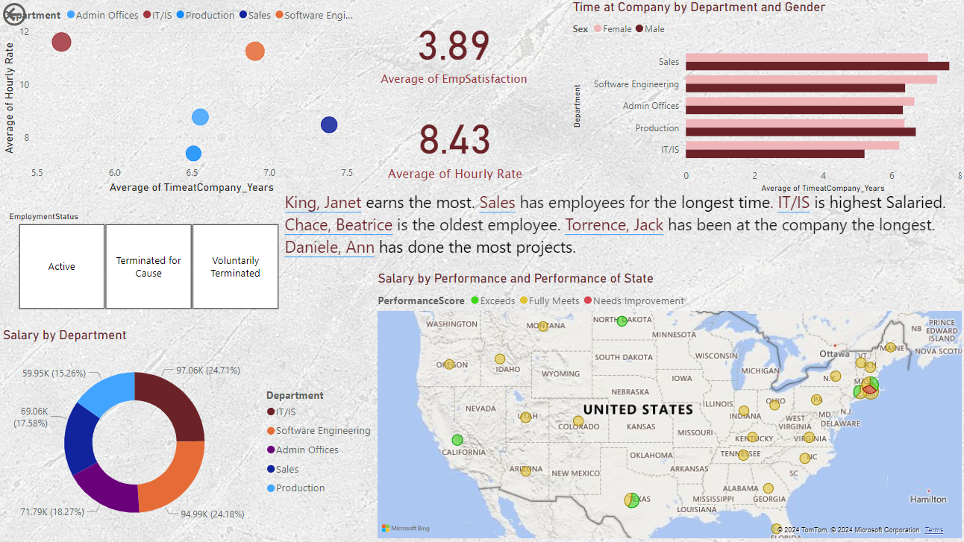
Visualizations
Scatter Plot
Cards
Clustered Bar Chart
Slicer
Text Box(With Visual Insights)
Pie Chart
Map

Slide 10
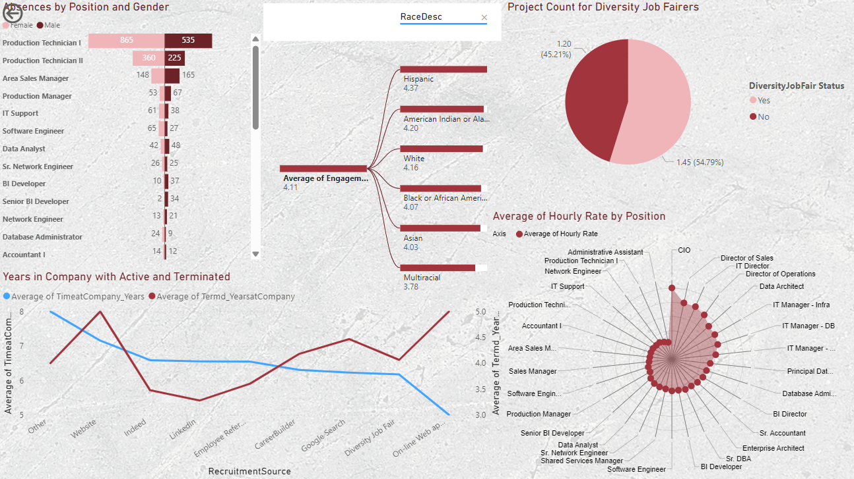
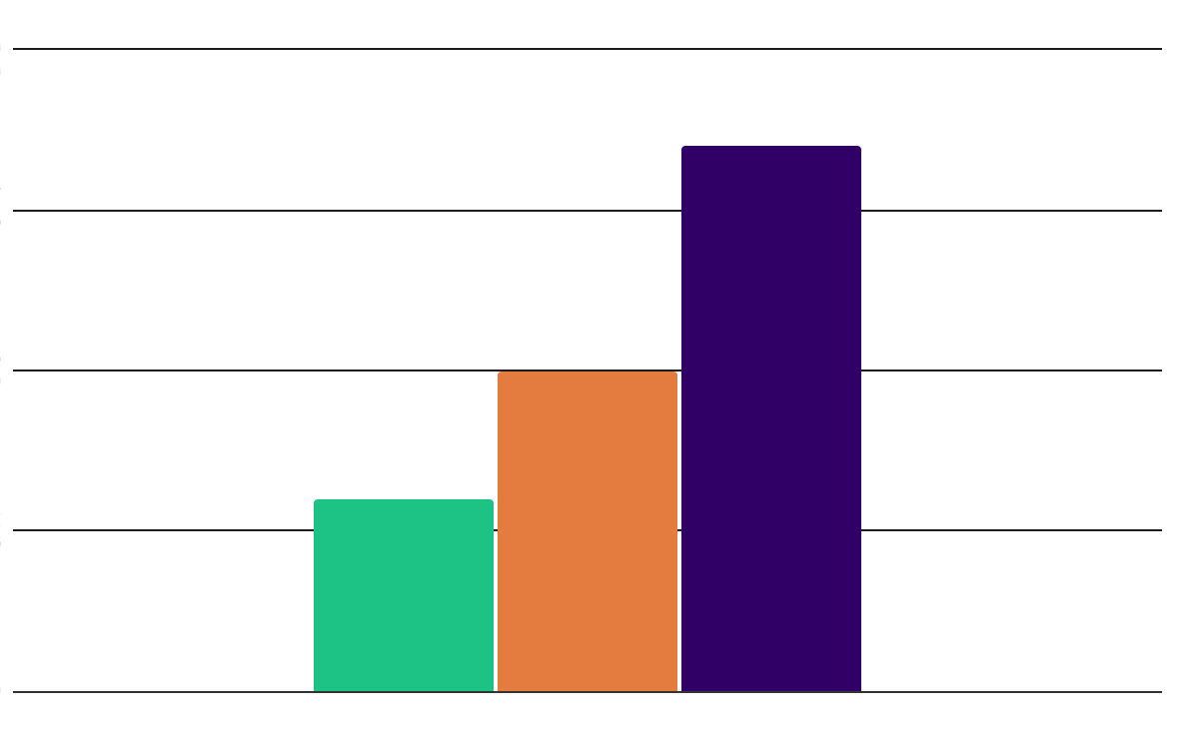
Tornado Chart
Decomposition Tree
Pie Chart
Line Chart
Radar Chart

Slide 11
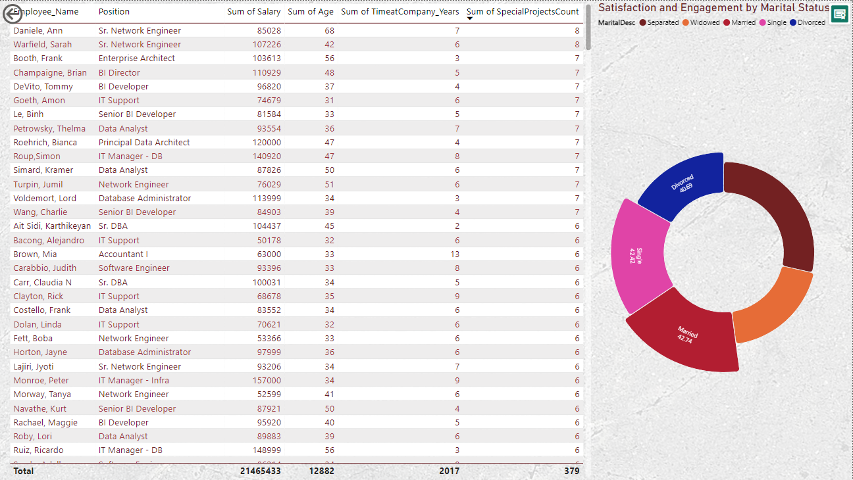
Table
Rose Donut Chart

Slide 12
THANK YOU!

